Slide 1

LaunchCode Liftoff
Class 1
Kevin Beashore 12/2/2021
* Adapted presentation by: Hank DeDona

Slide 2
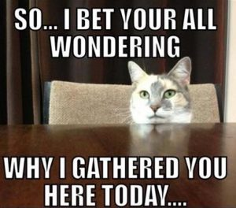
Agenda
Class Expectations
Prep Work Review
Liftoff Overview
Capstone Overview
Lecture
Group Introductions
Exercise - Story Mapping
Activity - Project Overview
Q&A

Slide 3
Class Expectations

Slide 4

Responsibilities - Course Manager
John Woolbright
Answer any questions about the placement and apprenticeship process
Post-class help
Additional mentorship

Slide 5

Responsibilities - Instructor
Expand on Prep Work In Class Lecture
Facilitate Group Activities
Make Class Accessible
Mentor (i.e. answer your questions :P)
Notes:
Won’t review Prep in depth, but rather touch on and open for questions/discussion
Lecture on important concepts - open discussion from students and mentors
Keep us on time
Accessibility, inclusion, etc

Slide 6
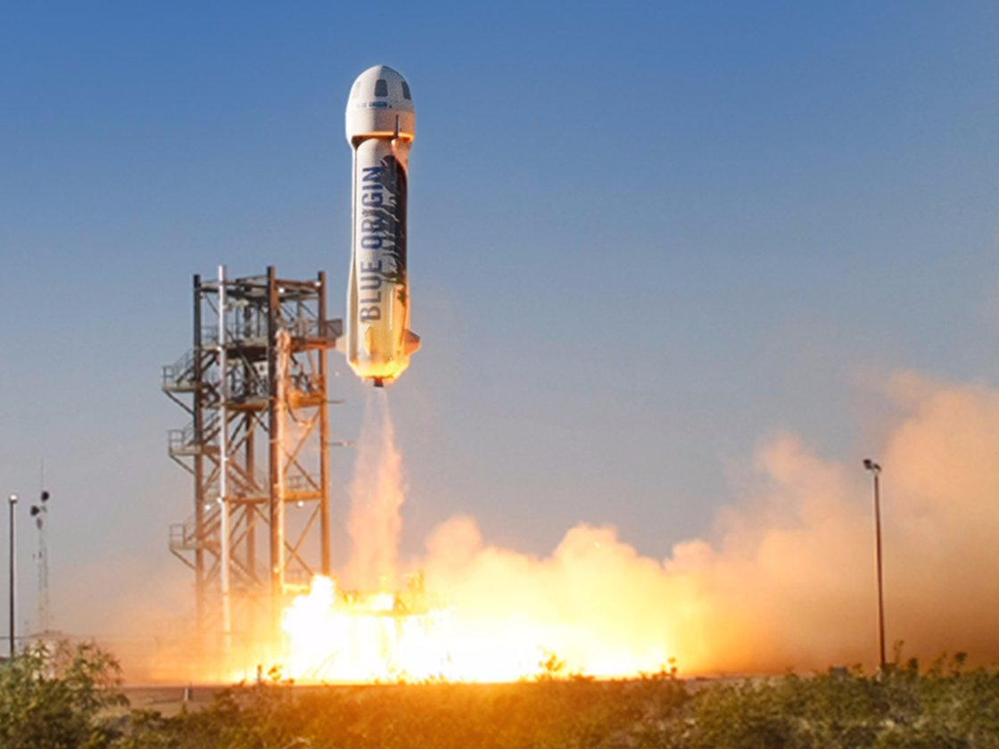

Responsibilities – Teaching Assistants
Provide Guidance and Feedback
Act as sounding board for your ideas
Tackle “Blockers”
Connect you with Mentors and Resources
Attendance and Grading

Slide 7

Responsibilities - Student
Dedicate Time Outside of Class – ~5 - 10 hours
Provide a Weekly Update to Your Group
Engaged in Lecture and Activities
Complete Prep Work and Assignments
Come Prepared to Class
https://education.launchcode.org/liftoff/articles/liftoff-expectations/
Notes:
20 hours is a lot, but you definitely should have multiple times a week you can dedicate
Weekly Updates - Want to see forward progress & get comfortable talking about it
Try not to ‘work’ during lecture & activities, or leave early
CoC and Harassment - Won’t stand for it, reach out to staff or myself
We don’t run this class because we love grading & lecturing (okay, I like lecturing)
Bring laptop, notebook, pen (especially next week)

Slide 8

Class 1 Objectives
Prework:
Review Liftoff expectations
Understand capstone goals
Key components of a capstone
Lecture:
How do you ideate, and build a project?
Story Mapping, Personas, and User Stories
In smaller groups:
Get to know your group and mentors
Solidify project ideas
write some user stories
Notes:
Bullets 2 and 3 are covered already.

Slide 9

Prep work
* If you have not gone over it, we are about to at a high level

Slide 10
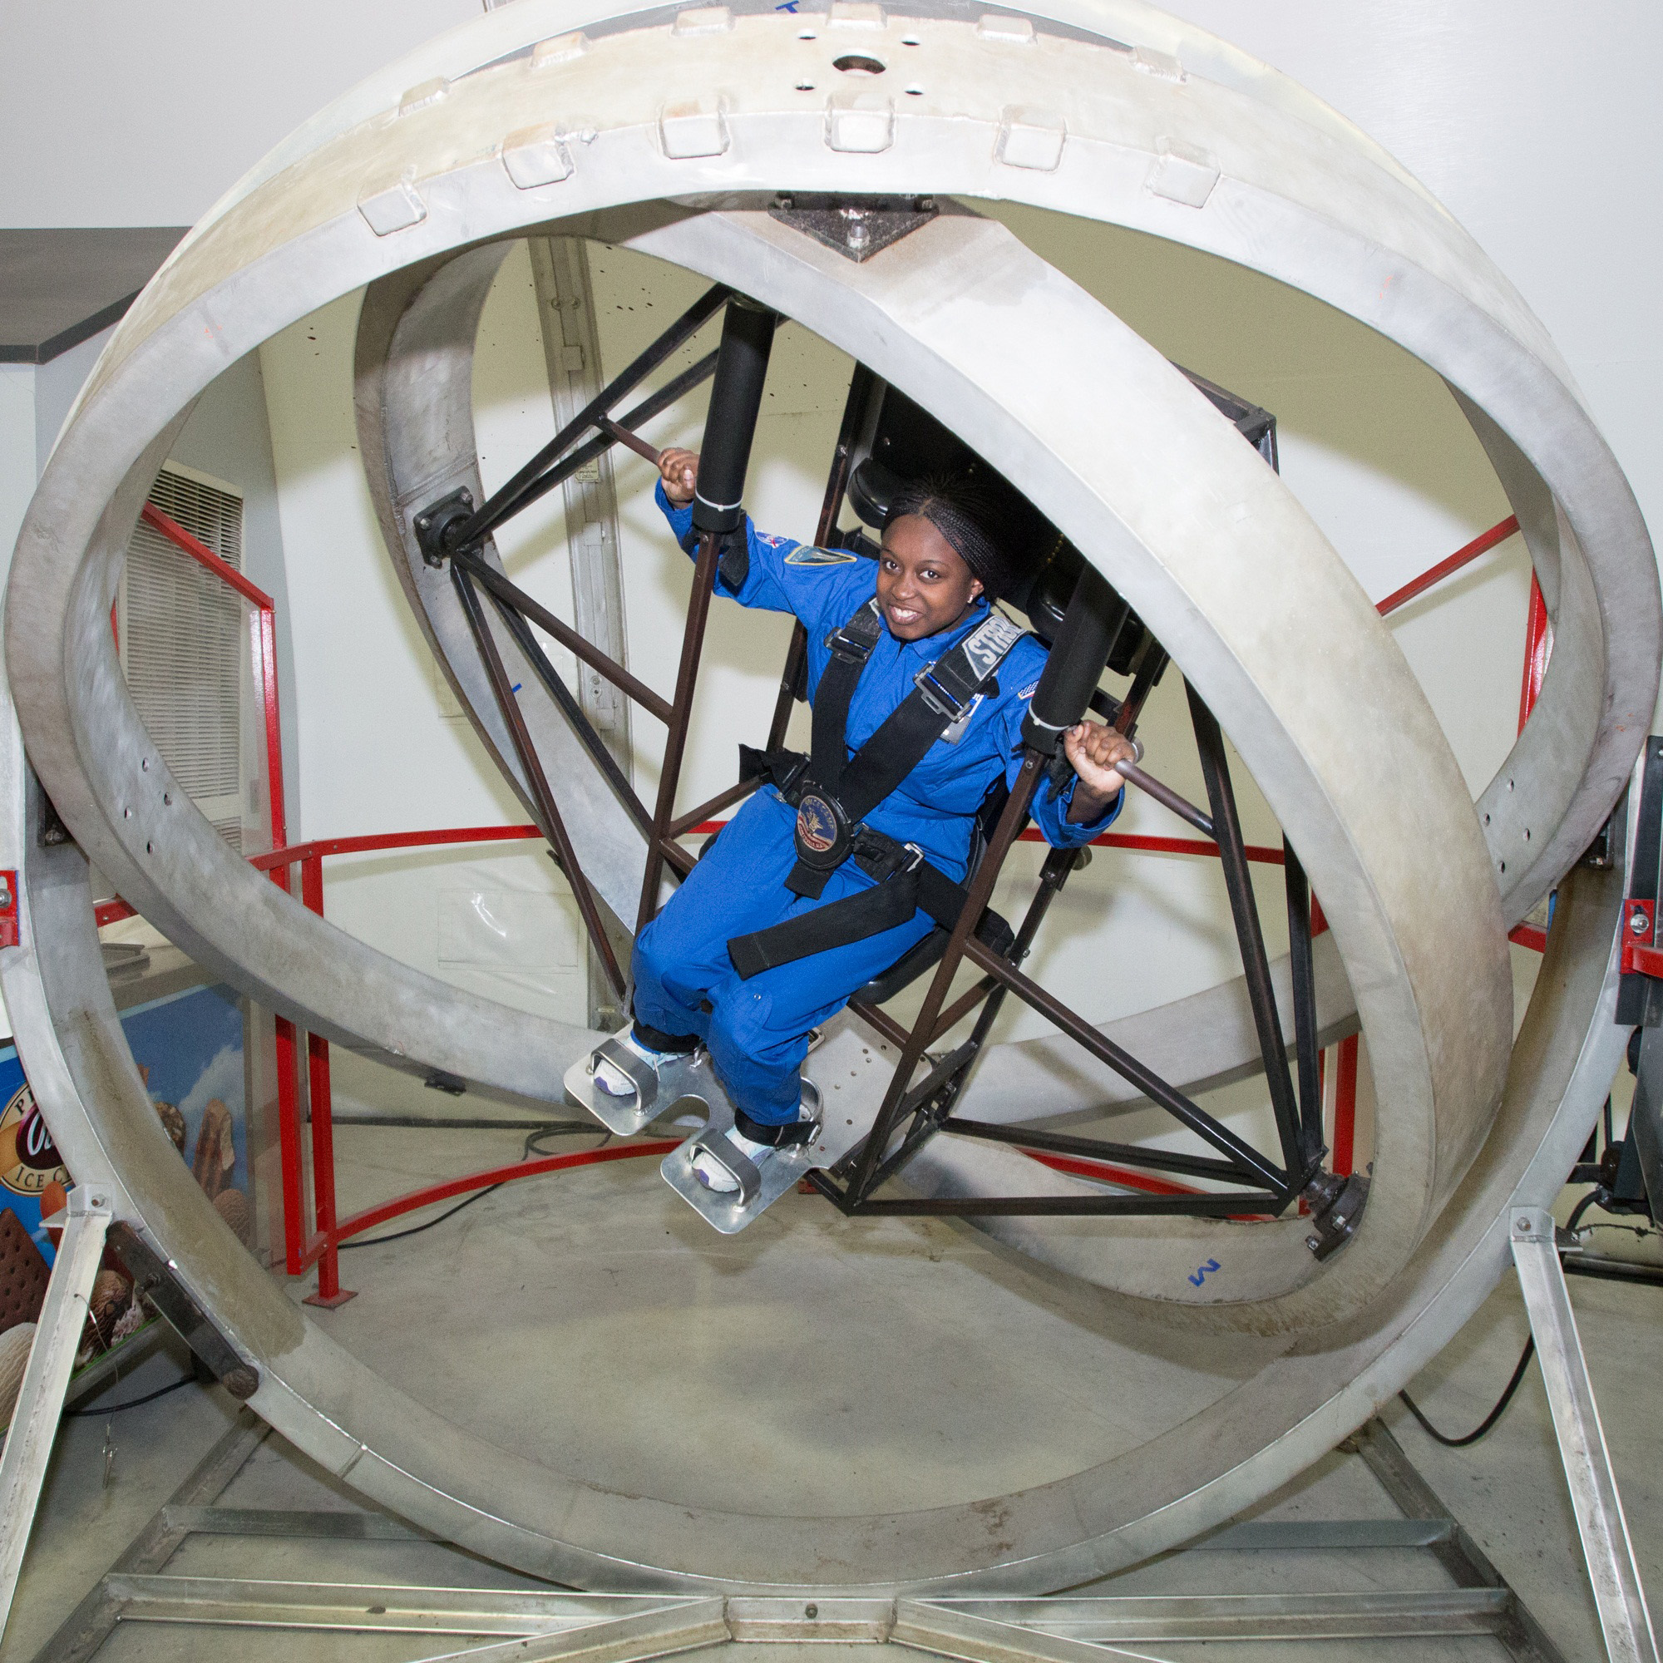
Prep Work
Liftoff Overview
Expectations & Project Overview
Assignment Repository
Trello account set up
Git Refresher
Capstone Project Guidelines
Fork GitHub Assignment Repository
This is your liftoff assignments outside of project
Understanding User Stories
DO
Notes:
Prep work generally means READING outside of a few things you gotta DO. But they should take too much time and if they are not done no biggy…go…. do them soon though

Slide 11
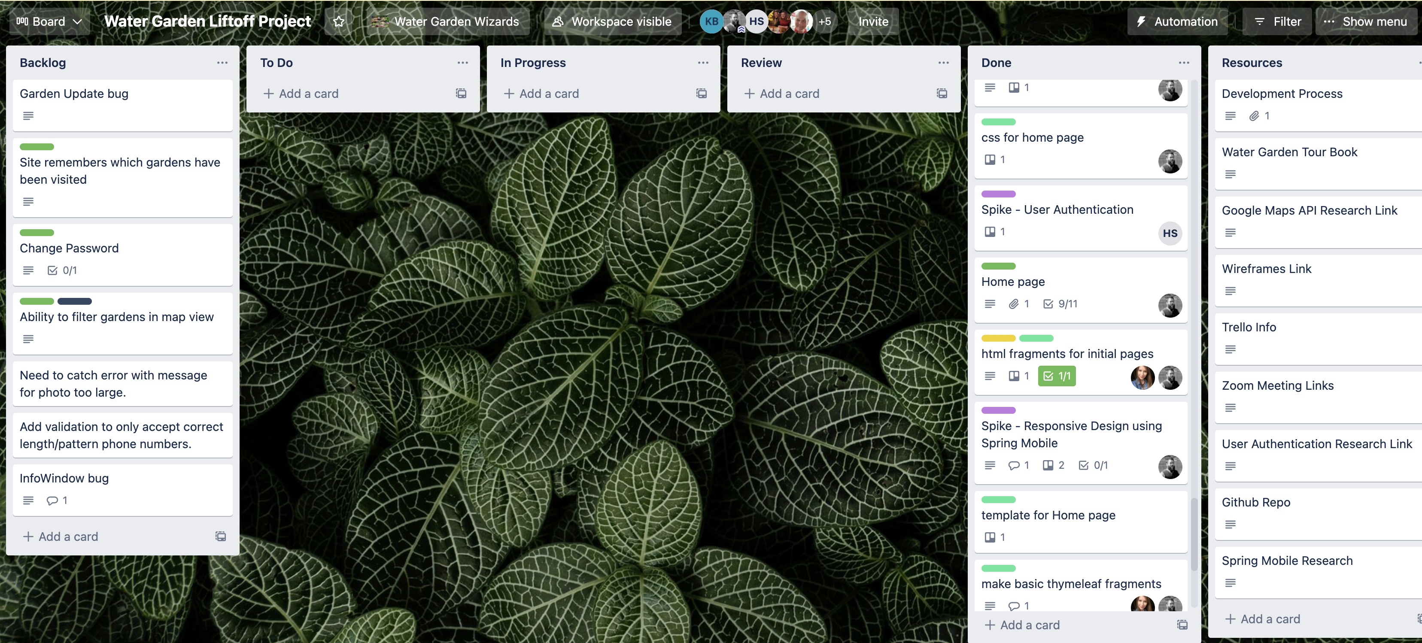
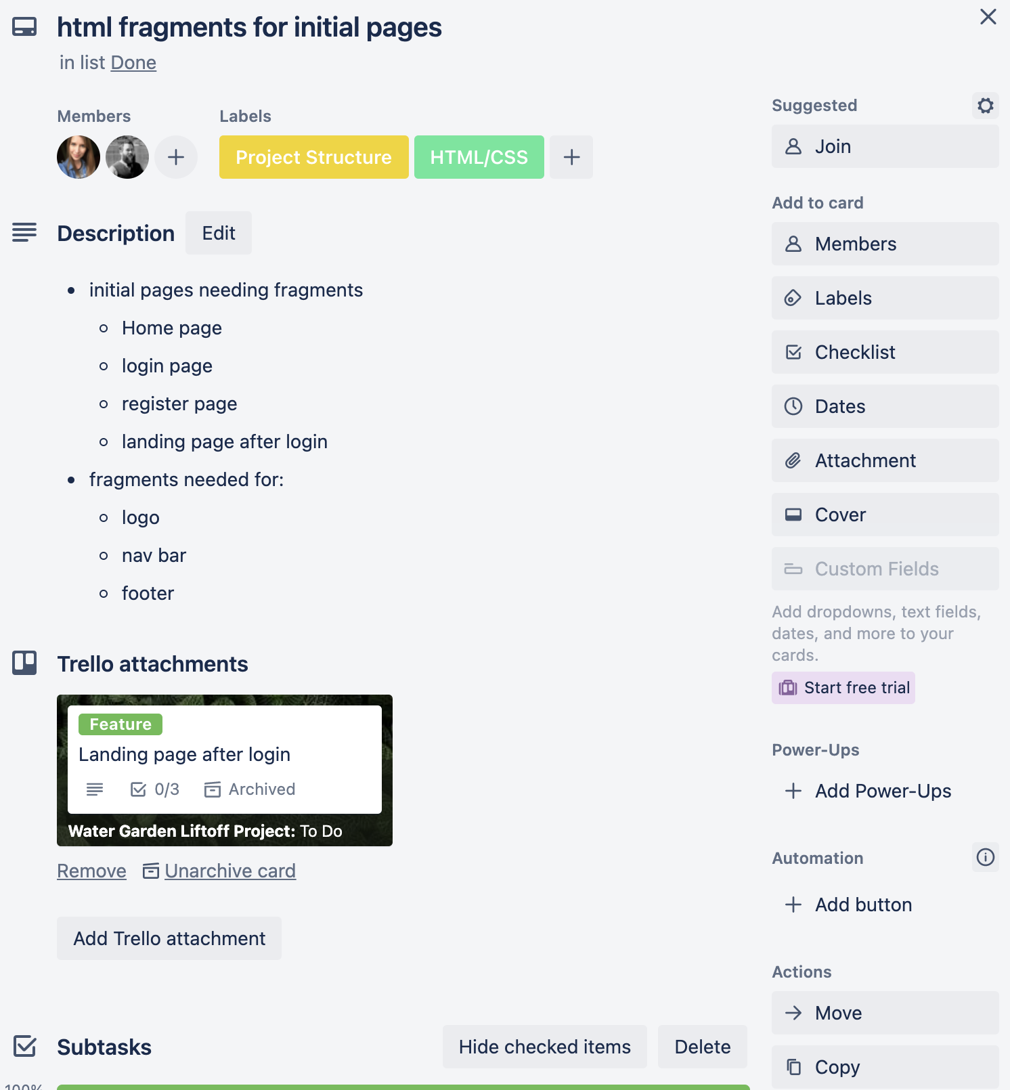
What is Trello?

Slide 12
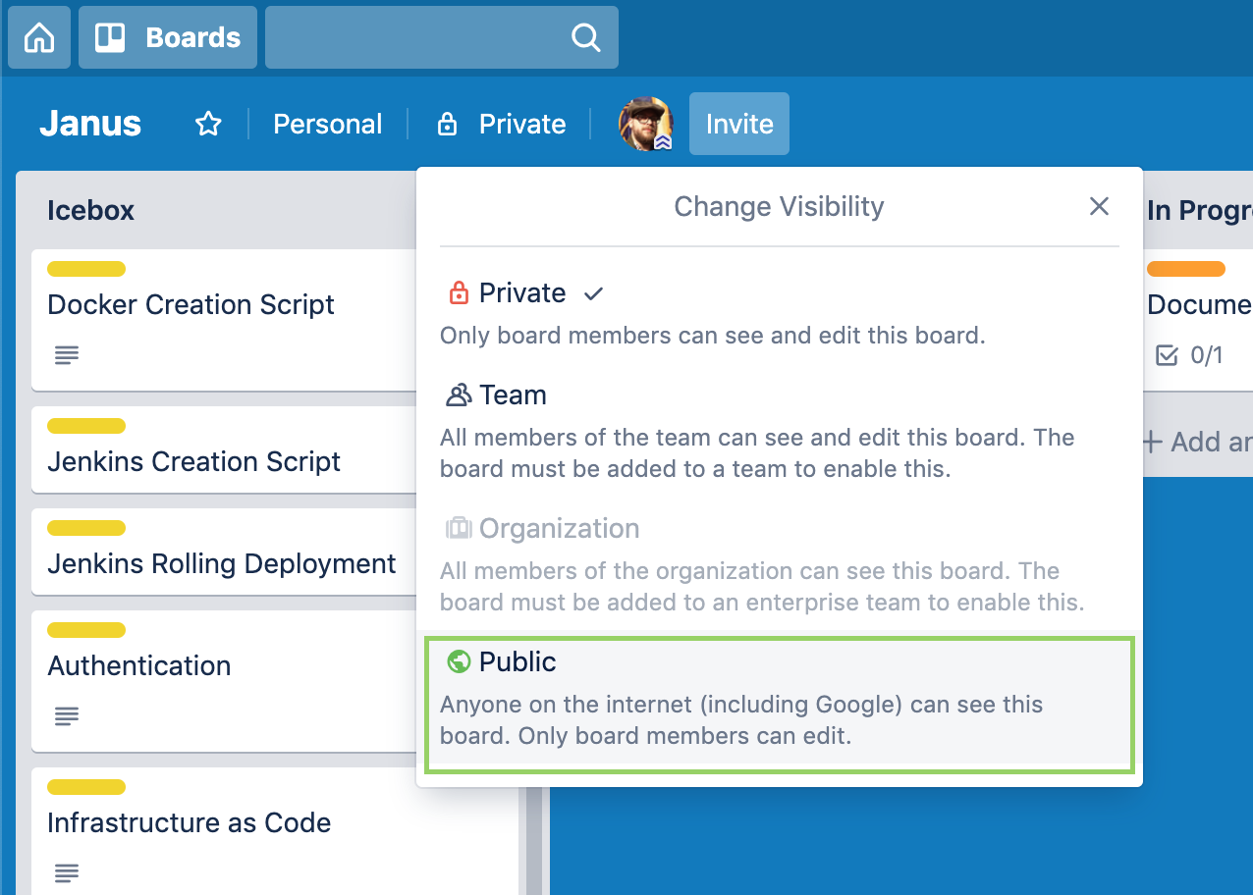
Trello Visibility Settings

Slide 13
Prep Work - Liftoff Overview

Slide 14

What is Liftoff?
Portfolio builder by:
Creating a Capstone Project.
Interview Prep Questions
Introduction to software engineering topics such as:
SDLC
Deployments, code reviews, etc
Trello (like jira)
Wireframing & UI/UX
Git
Your tech career
Liftoff
LC101
Notes:
A bridge from tech readiness, to job readiness
Focused on Having a Capstone to Present, not a “finished” one
Confidence in interviewing - Technical and Behavioral
Understanding modern software development processes - Agile, UX
8:30 - Be respectful of mentors & staff’s time, we need sleep too!
Similar LC101 format - Prep work, lecture, in-class demos & activities, and assignments
No requirements - self directed program (20 hrs) - Give you the tools & resources
This program does not guarantee you a job, you should still push yourself to grow and learn beyond the class

Slide 15
Prep Work - Capstone Overview

Slide 16

Capstone Expectations
Demonstrate Ability to Learn Things & work in teams (for some)
3-5 Features that showcase:
Marketable Skills that you find interesting
Ability to learn quickly in this course
Should show off a typical 3-tiered
Architecture (Model View Controller)
See some Example Projects
Demo projects in your book
Notes:
Marketable - We want to get you a job - It’s not the end of the world
Spring Boot or .NET MVC - Others, work with mentor. Mentors, reach out
More than just following a tutorial, but built
Could be a JS front end, api, more feature ideas later
Employers are looking for ability to learn, not master
Problem - Not a game, blog, or cheese catalog
Think about your interests, organizations, and jobs

Slide 17
Capstone Feature Ideas
User Accounts
Secure Login*
Profile Management
Access Levels
“Friends” Network
3rd Party API Integration
SMS (Twillio)
Payments (Stripe)
Dynamic Front End
JavaScript
Mobile Responsive
Google Maps Integration
Graphs & Dashboards
Photo Upload and Sharing
Social Media Integration
Notes:
Some that I have seen:
Water garden app, create printable quizzes for teachers, kitchen recipe website, blog site, etc

Slide 18
Liftoff Project Timeline
User Stories & Trello
Git, Licensing, & Online Profiles
Class 1
Class 3
Class 2
Class 4
Wireframes & Project Outline (MVP)
Project Review 1
Notes:
Aggressive goals so we can provide as much direction as possible
Weekly progress
Something to review by Week 4
Break week

Slide 19
Liftoff Project Timeline
Address Feedback & Technical Questions
Next Features & Interviewing
Class 5
Class 7
Class 6
Class 8
Next Features & Mock Interviews
Final Review
Notes:
More open format towards the end, start adding features
Final project review - May not be complete, but a good start

Slide 20
Lecture

Slide 21
Coding challenge
https://edabit.com/challenge/3CaszbdZYGN4otQD8

Slide 22
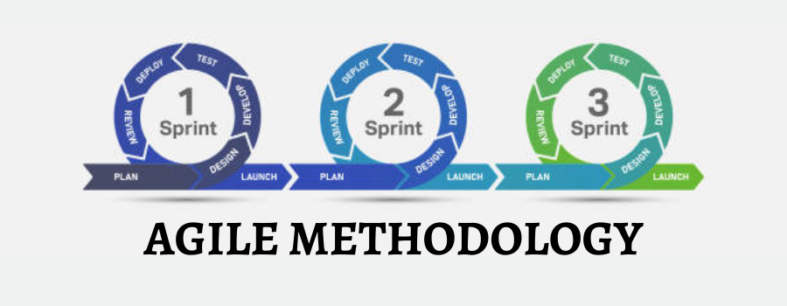
How do we ideate, and build a project??
...INSERTAGILE!!
Notes:
So we have this wonderful thing that solves all the worlds problems……..AGILE! It doesn’t really solve the problem but it helps….it’s just a process as we will see :D

Slide 23
What is Agile?
Defined as:
project management, that is characterized by the division of tasks into short phases of work and frequent reassessment and adaptation of plans.
Agile is an organization methodology, not a law
Not everyone does Agile
Those who do, do so differently
Refer to Agile Manifesto
https://agilemanifesto.org/

Slide 24
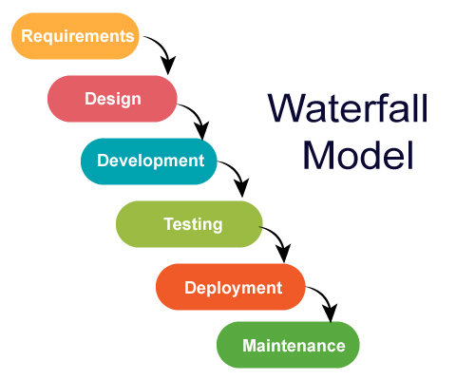
Why is Agile Important?
The “Way Things Were” - An Analogy of Waterfall
You Can’t Plan For Everything
Small, Iterative, Feedback Driven Development
Personal Project & Task Management
Notes:
RE: Prep Work - Take a step back and understand a bit about Agile,
Will revisit over the next few weeks
Lots of buzzwords & concepts - hope to demystify
Agile is just a way to plan, manage and build projects
Not everyone does agile, and no one does it the same way - concepts are the same

Slide 25
Agile Brainstorming & Process
Identify the Problem and Set a Goal (Brainstorming)
Identify Users (Personas)
Brainstorm the “Big Picture” (Story Mapping)
Target a Minimum Viable Product (MVP)
Create small, “vertical”/”horizontal” tasks (User Stories)
Get Feedback (User Demos & Code Review)
Lather, Rinse, Repeat (Iterate)
Notes:
MVP will come back later

Slide 26
Different Agile Methodologies
There are several different “implementations” or “methodologies” of Agile
Two of the more popular ones are Scrum and Kanban
Scrum – Set of meetings (ceremonies), tools, and roles that work together to achieve a goal
https://www.atlassian.com/agile/scrum
Kanban – Full transparency of work usually through a “Kanban Board”
https://www.atlassian.com/agile/kanban

Slide 27
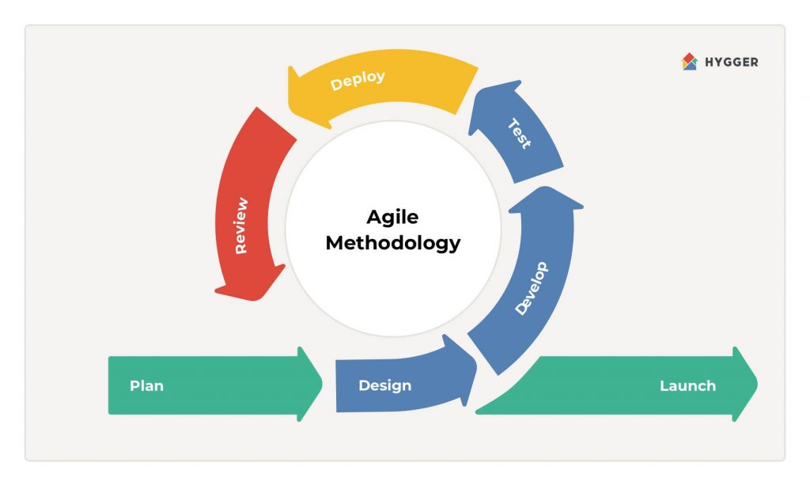
What does Agile look like
Sprint grooming/refinement
Sprint planning
Design what the work
Code the work (interchangeable with 5)
Test the work (QA maybe?)
Code Review
Deploy to “dev” env
Launch release
7
5
6
4
1
2
3
8
Demo between 7 and 8

Slide 28

Agile - Grooming User Stories
Break Down Stories
Add to Project Tracker
Size (S, M, L, XL)
Prioritize
Identify MVP Stories
Find Dependencies

Slide 29
Creating User Stories
As a <persona>, I want to <do something>, so that <end result>
Gives Context to a Task (Who, What, Why)
Smaller is Better
Vertical Slicing - Focused on User’s Experience
Examples:
As a shopper, I want a landing page when I visit the site, so that I know I’m in the right spot
As a seller, I want to provide a good description, so that shoppers know what they’re buying
As a shopper, I want to view by category, so that I quickly find what I need
As a shopper, I want to pay using PayPal, so that I can easily complete my purchase

Slide 30

Good User Story
Bad User Story

Slide 31
“User sign up page”

Slide 32


Slide 33
“I want to register so I can use your app”

Slide 35
“As a new user, I want to register for an account, so that I can start taking attendance.”

Slide 36


Slide 37
“As a user, I want to see an attendance report.”
Notes:
This is better then other bad ideas but it is missing the why….WHY do we want to see an attendance report?

Slide 39
“As a LaunchCode Employee, I want to see an attendance report of the current classes, so that I can connect with absentee students”

Slide 41
Story Mapping

Slide 42
Story Mapping
Identifying Key Features (Epics)
Epics Are the Key Features of Your Application
Details That Build the Epic (Stories)
How a User Interacts With that Feature
Alternative Solutions
Not Detailed and Focused Like a User Story
Struggling to Find Epics?
Focus on Rough Stories
Group and Sort by User’s Journey
Groups can Form Epics
Notes:
Show a Couple Examples, then Demo
Features can be a “muddied” term

Slide 43
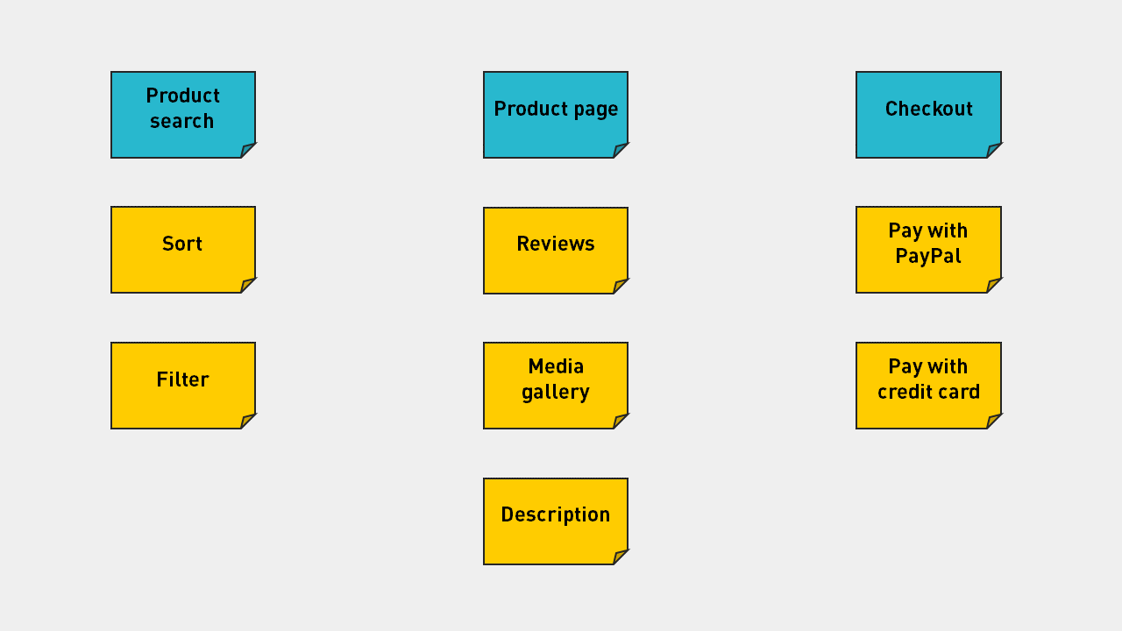
Story Mapping - eCommerce Example
Notes:
Identify Key Features - ecommerce example - Search, product, checkout

Slide 44
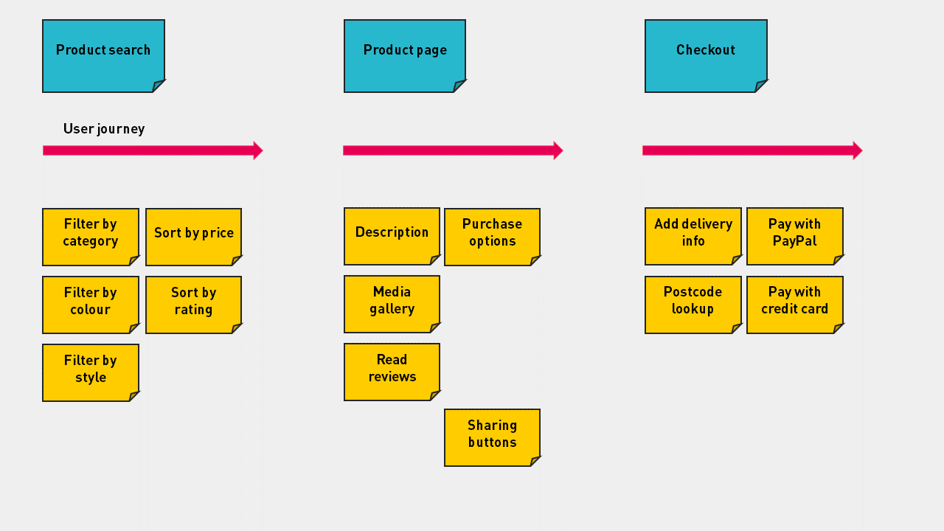
Creating Stories - eCommerce Example
A flow a user would take on a given page

Slide 45
How to Break Down the “Big Rocks”
NOTE: Smaller Units of Work are More Manageable and Rewarding
Notes:
No longer spoon fed what and how to build a project

Slide 46
Review
Agile and Waterfall are project management methodologies used for organization of project development.
How to break down a task?
Understand the problem and then break it down to small vertical slices for testability.
Remember order of Trello/Jiras tasks (Epic -> stories -> tasks -> subtasks
User stories tell the Who, What, & Why. User stories tend to follow a pattern: As a <persona>, I want to <do something>, so that <end result>

